Slide 1
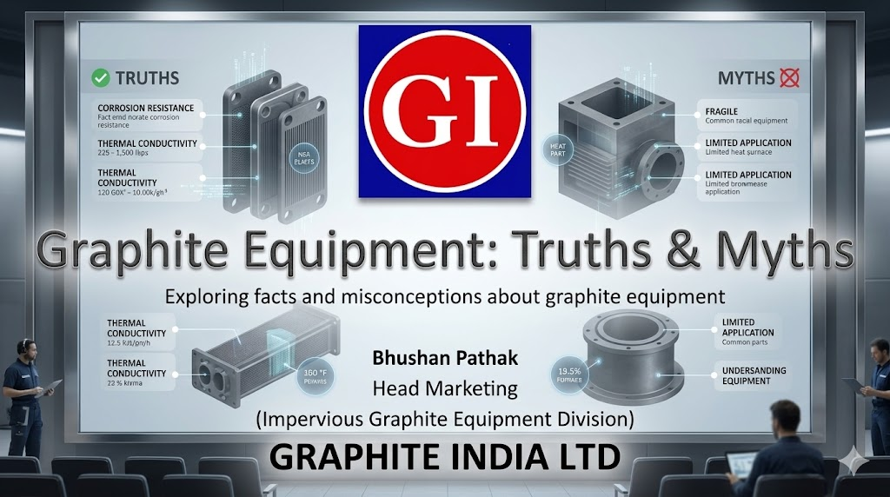

Slide 2


Who are We?
In 1983 We collaborated with Vicarb SA, France & started an integrated facility for design, manufacture and supply of Graphite Heat, Mass Transfer & Turnkey Systems under the name ‘Graphite Vicarb’. Collaboration lasted till 1994 as Vicarb was sold out.
1967
1995
2004
2018 Onwards we ventured in new business in various sectors like Graphene, EV & Traction Batteries, Solar and Wind Power plants etc
In year 2002 our final consolidation took place, and all group companies came under name of Graphite India
‘Graphite India Limited’ (GIL) commenced manufacturing Graphite Electrodes as well as Carbon & Graphite Specialty products in 1967 in collaboration with Great Lakes Carbon Corporation of USA.
The name of company was changed to Carbon Everflow Ltd. in 1995 after merger of Nashik based company divisions (Graphite Electrodes, Equipment & Glass Reinforced Plastics division).
2002
Graphite India acquired a German company, Conradty COVA Service GmbH in Bavaria State, Nuremberg. Company renamed as – Graphite COVA GmbH.
2018
1983

Slide 3
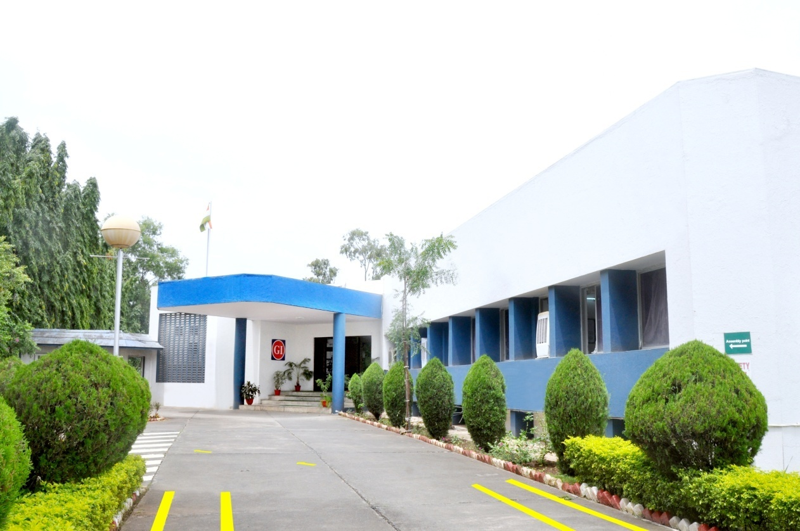



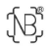
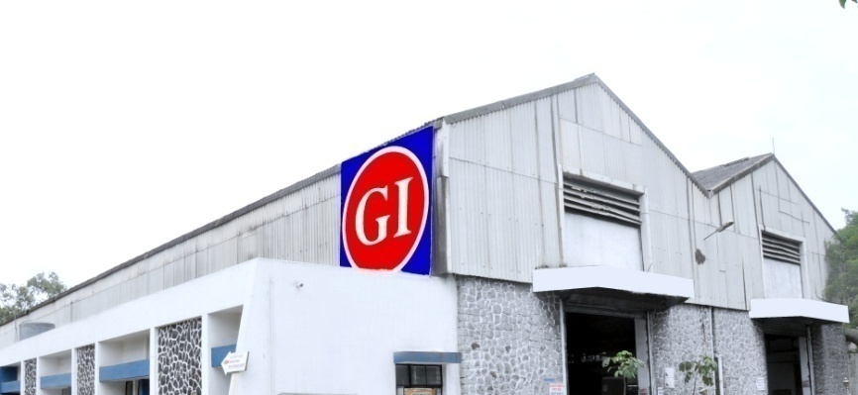
Impervious Graphite Equipment Division
We are amongst leading Graphite equipment manufacturers in the world.
Our products - Heat and Mass transfer Equipment, Turn-key systems - with proven excellence in performance are designed and manufactured to handle corrosive chemicals.
We are one of the top 500 BRSR companies identified by SEBI for adherence of ESG Regulations
Certifications
Thermal, Process and Mechanical Design
ISO 9001, 45001, 14001, 50001 Certification by TÜV Nord
Process automation
ASME “U” Stamp & National Board “R” Stamp
After-sales services
The National Board “NB” Stamp
Eco Vadis awarded a Commitment Badge to us in recognition of sustainability achievement

Slide 4
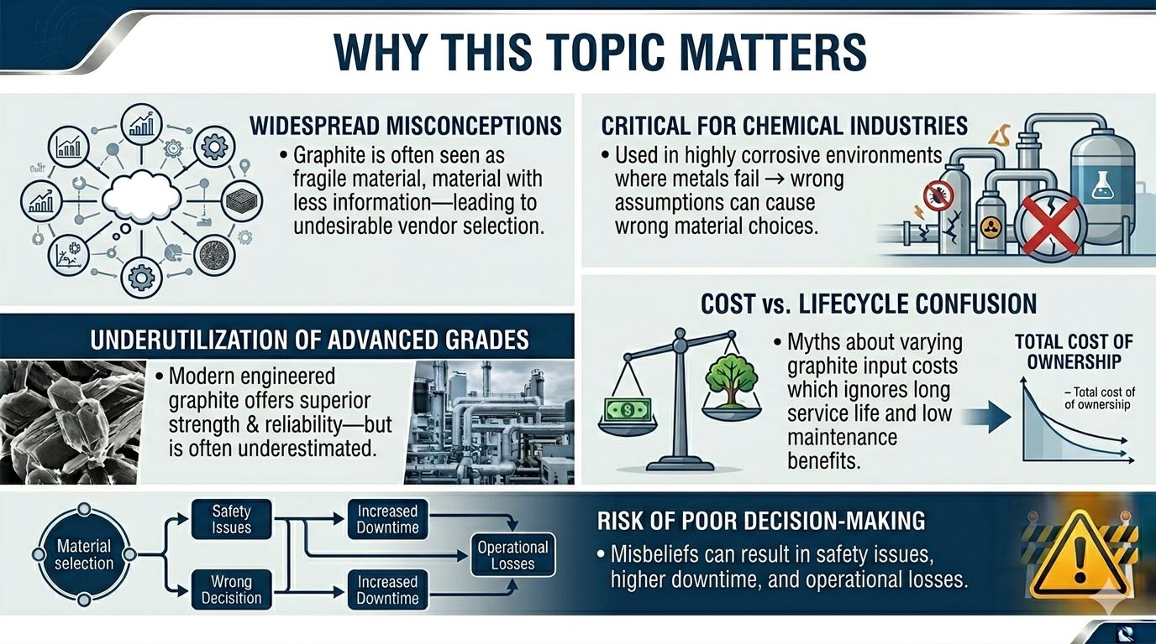

Slide 5
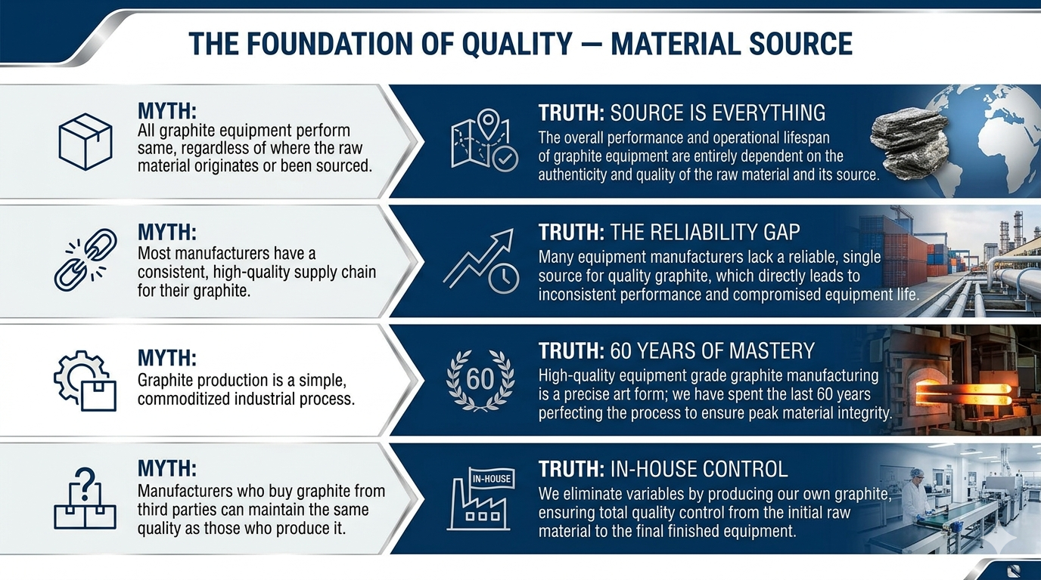

Slide 6
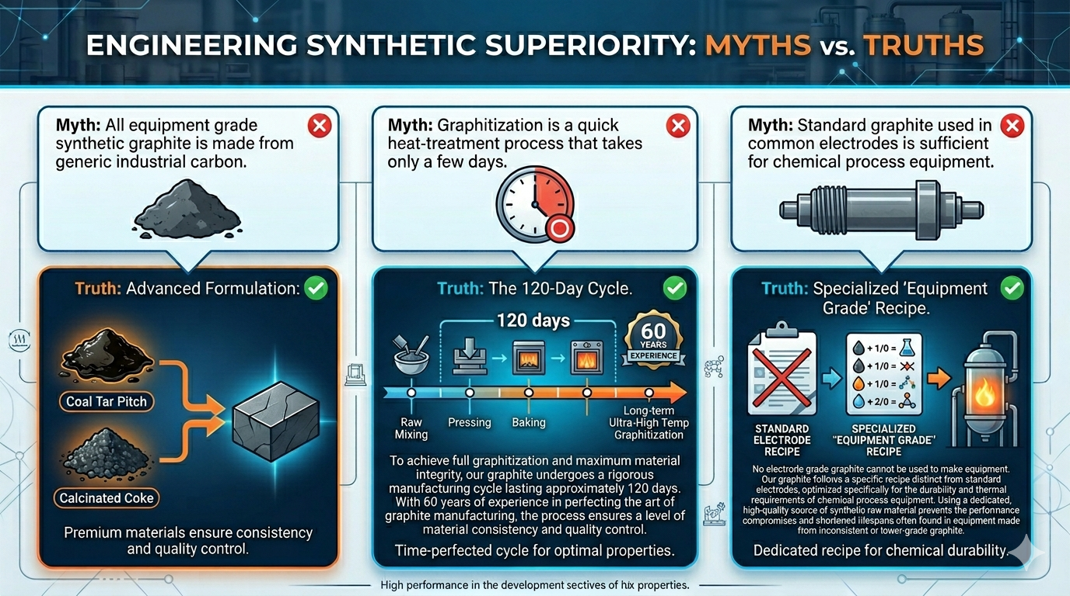

Slide 7
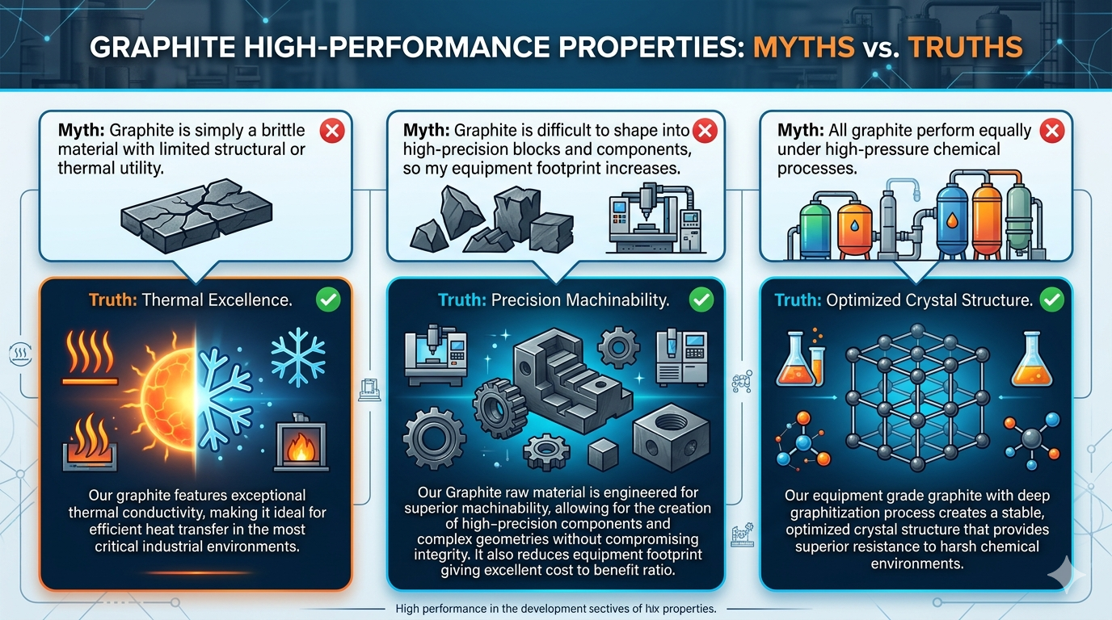

Slide 8
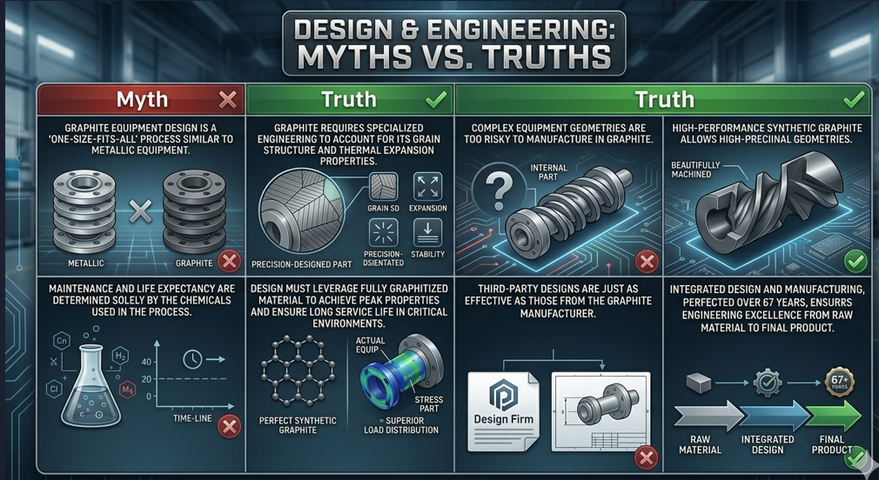

Slide 9
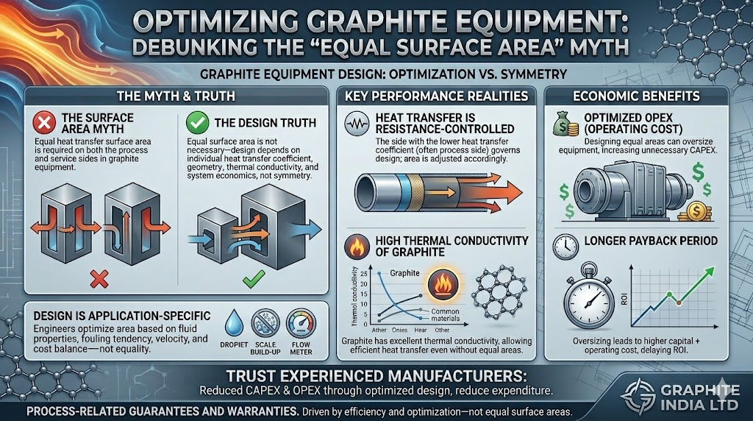

Slide 10
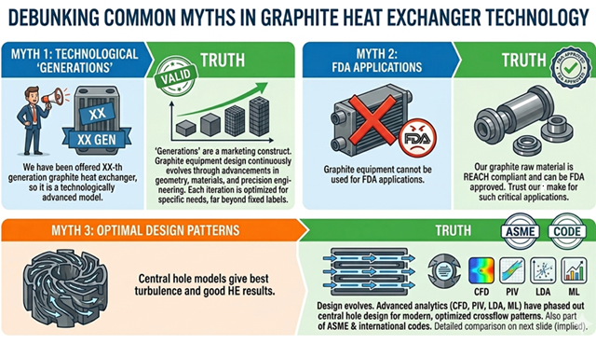

Slide 11
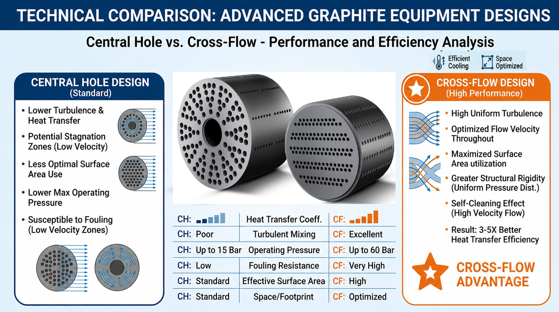
Geometry of Blocks – Myths & Truths

Slide 12
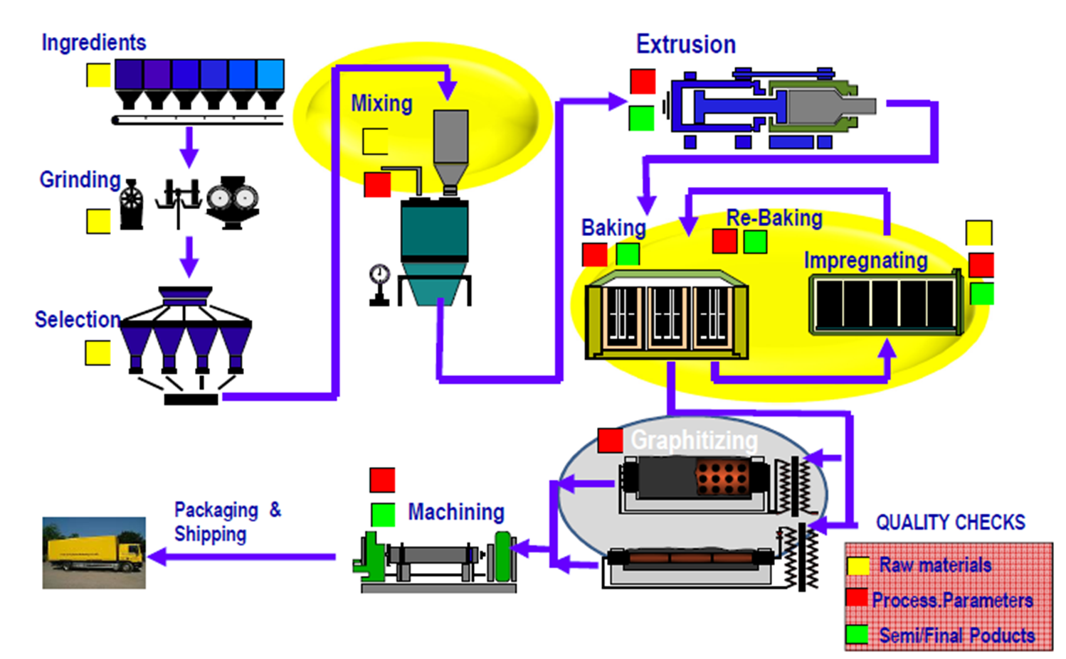
Brief manufacturing process of our Graphite
Graphite is produced by blending petroleum coke & molten pitch.
Coke is blended with Pitch to form a homogenous mass, further extruded through dies as round or cubical block or tube.
The extruded mass cooled to prevent from losing its shape and further loaded into baking furnace and heated up to 1000 deg C temperature.
During this process solid porous material is formed which is nothing but a Amorphous carbon structure.
In this structure the carbon atoms are randomly placed. This material is impregnated with pitch to fill the pores.
Thereafter Amorphous carbon is converted into crystalline form which is more ordered structure, by heating at 3000 deg C temperature.
This process is called Graphitization and through this process only graphite obtains its essential properties such as excellent electrical and thermal conductivity, corrosion resistance, machinability, mechanical strength, etc.
During the process of baking and graphitization, the volatiles in the pitch and cokes are driven off thereby leaving the pores.

Slide 13
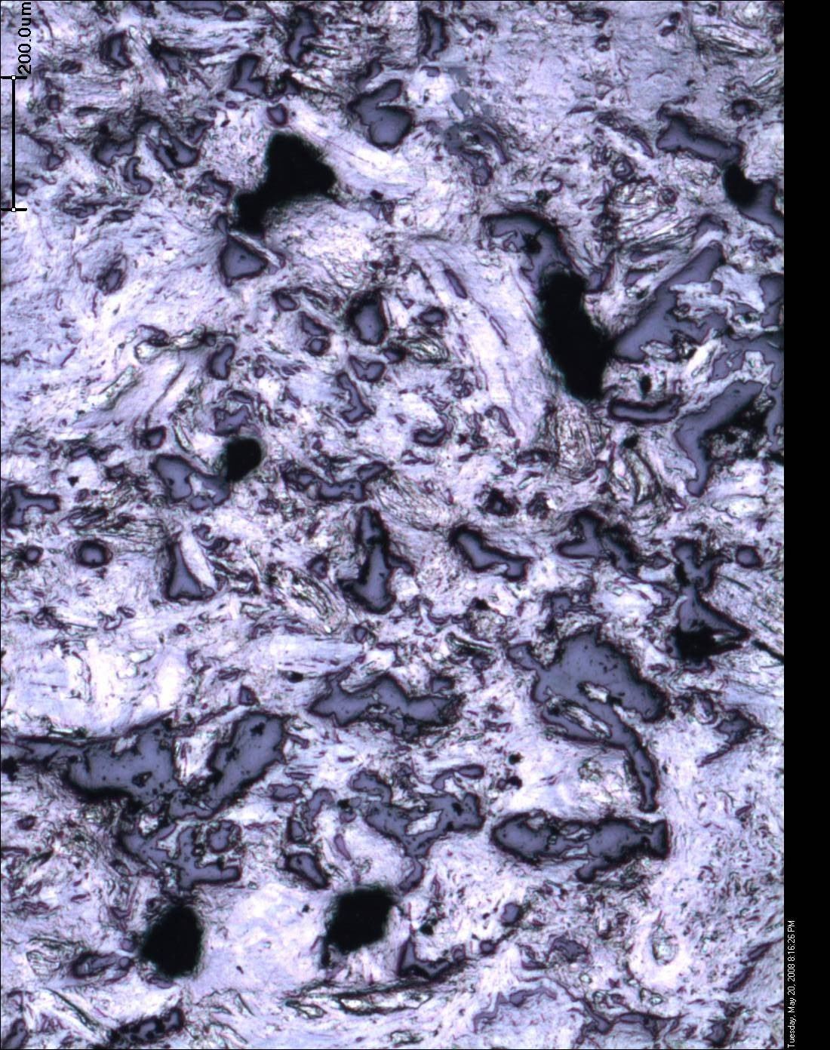
Properties of our Graphite
Typical Physical Properties of Impregnated Graphite | Blocks | Tubes
Density gm/cc | 1.8-1.9 | 1.8-1.9
Thermal Conductivity W/m°c | 170-213 | 74-89
Tensile Strength N/mm² | 20-24 | 27-33
Flexural Strength N/mm² | 30-36 | 45-56
Compressive Strength N/mm² | 60-70 | 75-90
Co-efficient of thermal expansion mm/mm/°C x 10⁻⁶ | 3-4 | 3-4
Permeability cm²/sec x 10⁻⁶ | 2-3 | 3-4
General Suitability:
Phenolic Impregnated Graphite: 190° C, PTFE Impregnated Graphite: 230° C
This material is composed of a mix of fine and coarse grain sizes. This blend makes it more flexible, and elastic compared to fine-grained materials, which are more prone to failure due to a uniform grain size.

Slide 14
Significance of Graphite Properties
Tensile Strength: It is the maximum amount of tensile stress that it can take before failure. (Graphite : ~22 N/mm2, Carbon Steel : 485~620 N/mm2)
Compressive Strength: It is the maximum amount of compressive stress that it can take before failure.
Flexural Strength: It is defined as a material's ability to resist deformation under load.
Our graphite material is fully graphitized. Fully graphitized equipment grade material generally have compressive strength 2.5 times and flexural strength 1.5 times of that of tensile strength.
CTE: The coefficient of thermal expansion describes how the size of an object changes with a change in temperature.
Thermal conductivity: the rate at which heat passes through a specified material, expressed as the amount of heat that flows per unit time through a unit area with a temperature gradient of one degree per unit distance.
Our graphite material which is fully graphitized and made with mixed grain size have highest coefficient of thermal conductivity . This is an key parameter in designing of heat transfer equipment.
Permeability: the ability of material to allow fluids to pass through it.
Thermal Shock resistance: It is ability of solid material to withstand sudden changes in temperature either due to heating or cooling
Iron Migration : Intolerable in food products, API/Bulk drug pharmaceuticals, etc.
Our permeability is as per ASME UIG requirement 10 ⁻⁶ cm2/sec, our graphite being middle grain size is having better Thermal Schock Resistance.

Slide 15
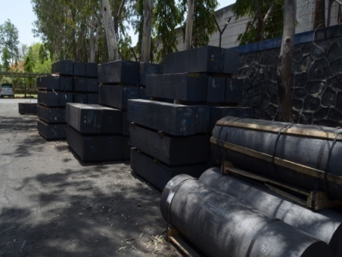
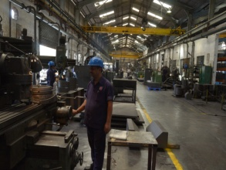
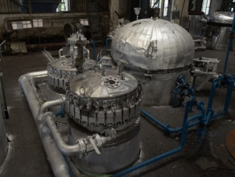
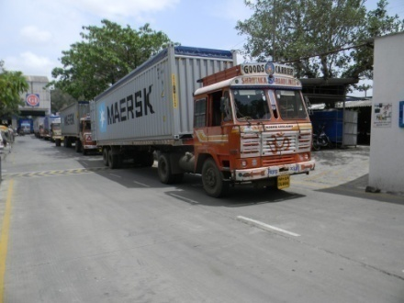
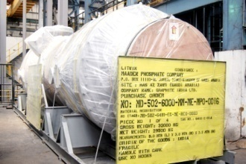
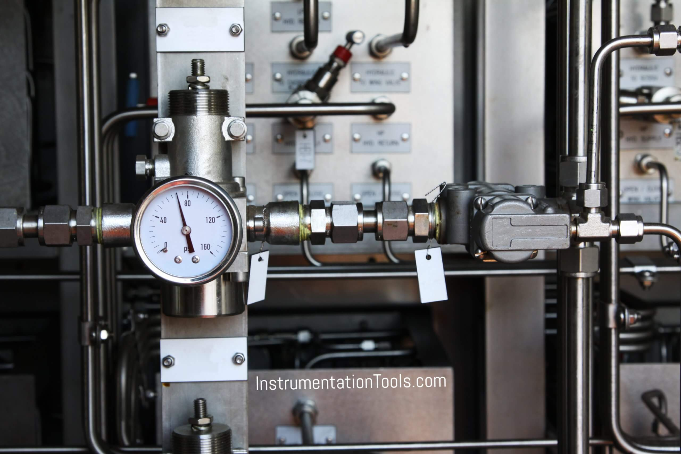
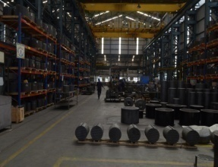
Raw Graphite To Impervious Graphite Equipment
Raw Graphite
Machining
Impregnation & Curing
Graphite component pressure testing
Dispatch
Painting / Packing
Inspection & testing
Assembly

Slide 16

THANK YOU
FROM TEAM GRAPHITE INDIA

